Slide 1
CSC410 - Professional Practices in IT
Instructor Name : Sidra Nasir

Slide 2
Today Topics
New Restrictions on Use
Peer-to-Peer Networks and Cyberlockers

Slide 3
New Restrictions on Use

Slide 4
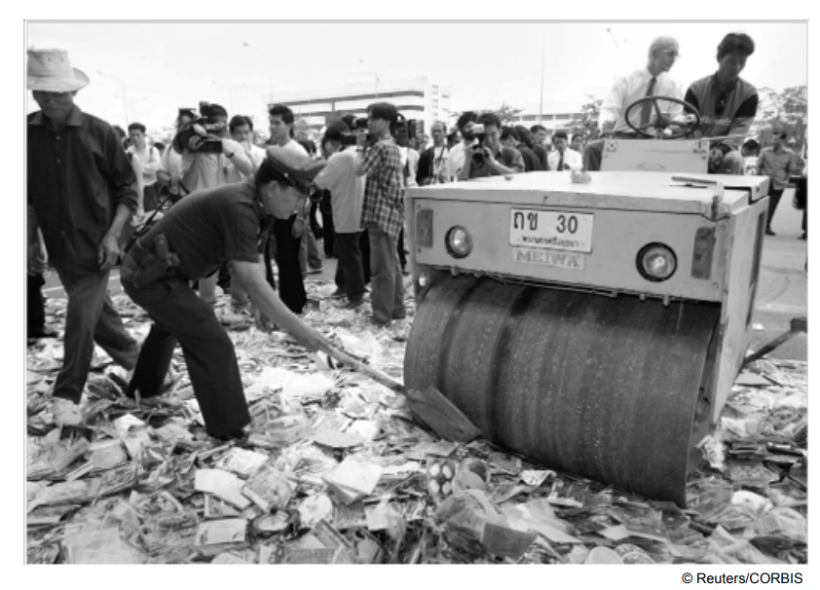
Counterfeit CDs = Lost Profits

Slide 5
Digital Millennium Copyright Act
First big revision of copyright law since 1976
Brought U.S. into compliance with Europe •
Extended length of copyright
Extended copyright protection to music broadcast over Internet
Made it illegal for anyone to
– Circumvent encryption schemes placed on digital media
– Circumvent copy controls, even for fair use purposes

Slide 6
Digital Rights Management
Actions owners of intellectual property in digital form take to protect their rights
Approaches
– Encrypt digital content
– Mark digital content so devices can recognize content as copy-protected

Slide 7
Secure Digital Music Initiative
Goals
– Create copy-protected CDs
– Secure digital music downloads
Consortium of 200 companies developed “digital watermarking” scheme
Failed
– Internet copying became huge before SDMI ready
– Some SDMI sponsors were electronics companies
– Digital watermarking encryption cracked

Slide 8
Sony BMG Music Entertainment Rootkit
Millions of audio CDs shipped with Extended Copy Protection, a DRM(Digital Rights Management) system
Prevented users from
– Ripping audio tracks into MP3 format
– Making more than 3 backup copies
Relied upon Windows “rootkit” that hid files and processes; usually only hackers use rootkits
Huge public outcry once secret uncovered
Sony BMG stopped production and compensated consumers

Slide 9
Encrypting DVDs
Contents of DVDs encrypted using Content Scramble System (CSS)
Need decryption keys to view a DVD
Jon Johansen wrote a decryption program for Linux
2600 Magazine published the code
Motion picture studios sued 2600 Magazine and won
Johansen tried in Norway and found not guilty

Slide 10
Foiling HD-DVD Encryption
Hardware, software, and entertainment companies created Advanced Access Content System to encrypt HD-DVDs
Encryption key posted on Digg.com
AACS leaned on Digg.com to censor postings containing key
Digg users fought back
AACS “expired” the key and issued a new one
A month later, a Digg user posted the new key

Slide 11
Criticisms of Digital Rights Management
Any technological “fix” is bound to fail
DRM((Digital Rights Management) undermines fair use
DRM could reduce competition
Some schemes make anonymous access impossible

Slide 12
Online Music Stores Employed Digital Rights Management
When iTunes Music Store opened, all music was protected with a DRM scheme called FairPlay
FairPlay blocked users from freely exchanging purchased music
– Songs couldn’t be played on more than 5 different computers
– Songs couldn’t be copied onto CDs more than 7 times
Songs purchased from iTunes Store wouldn’t play on non-Apple devices
DRM-protected music purchased from other online retailers couldn’t be played on iPod

Slide 13
Online Music Stores Drop Digital Rights Management
Consumers complained about restrictions associated with DRM
European governments put pressure on Apple to license FairPlay or stop using DRM
Amazon reached an agreement with all four major music labels to sell DRM-free music
Apple followed suit in 2009

Slide 14
Microsoft Xbox One
Microsoft announced cloud-based gaming experience for Xbox One (June 2013)
– User could play any game without disc in tray
– Automatic software updates of every Xbox One
• Controversial features of licensing arrangement
– Disc could be shared only once
– Second-hand market restricted
– Xbox consoles would have to check in every 24 hours
• Microsoft backtracked
– No need to connect to Internet
– Freedom to lend, rent, buy, sell discs
– Disc must be in tray to play game

Slide 15
Peer-to-Peer Networks and Cyberlockers

Slide 16
Peer-to-Peer Networks
Peer-to-peer network
– Transient network
– Connects computers running same networking program
– Computers can access files stored on each other’s hard drives
How P2P networks facilitate data exchange
– Give each user access to data stored in many other computers
– Support simultaneous file transfers among arbitrary pairs of computers
– Allow users to identify systems with faster file exchange speeds

Slide 17
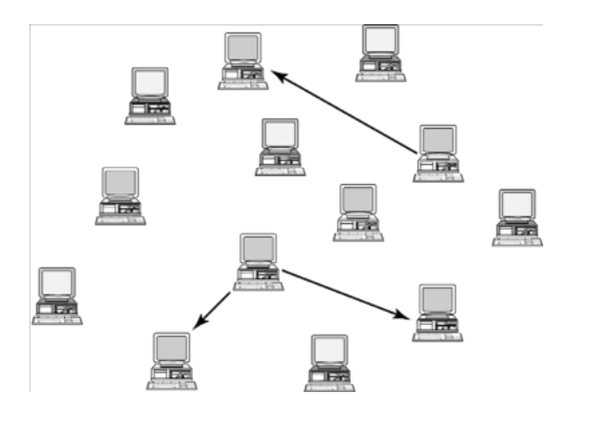
A Peer-to-Peer Network

Slide 18
Cyberlockers
Also called file-hosting services or cloud storage services
Internet-based file-sharing services
Allow users to upload and download password-protected files
Support workgroup collaboration
Make sharing of copyrighted material easy

Slide 19
Napster
Peer-to-peer music exchange network
Began operation in 1999
Sued by RIAA(Recording Industry Association of America) for copyright violations
Courts ruled in favor of RIAA
Went off-line in July 2001
Re-emerged in 2003 as a subscription music service

Slide 20
FastTrack
Second-generation peer-to-peer network technology
Used by KaZaA and Grokster
Distributes index among large number of “supernodes”
Cannot be shut down as easily as Napster

Slide 21
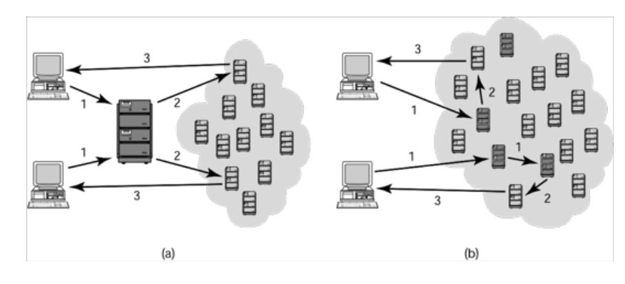
Comparing Napster and FastTrack

Slide 22
BitTorrent
Broadband connections: download much faster than upload
BitTorrent speeds downloading
– Files broken into pieces
– Different pieces downloaded from different computers
Used for downloading large files
– Computer programs
– Television shows
– Movies

Slide 23
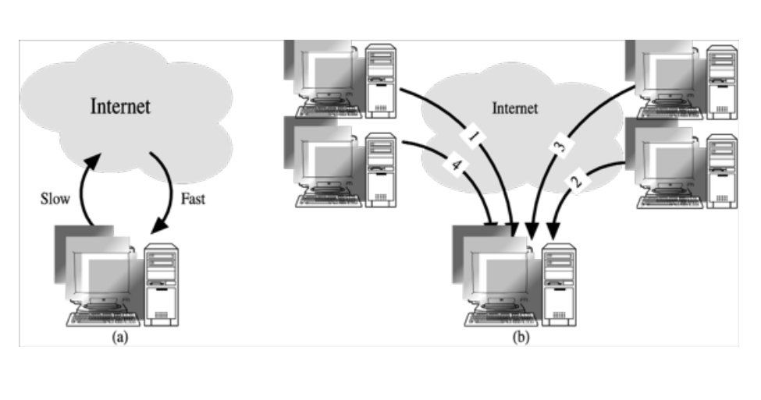
Concept Behind BitTorrent

Slide 24
RIAA Lawsuits
April 2003: RIAA warned file swappers they could face legal penalties
RIAA subpoenaed Verizon for identities of people suspected of running super nodes
In June 2003, a judge ruled that Verizon had to release the names of these customers
September 2003: RIAA sued 261 individuals
December 2003: U.S. Court of Appeals ruled Verizon did not have to give customer names to RIAA

Slide 25
MGM v. Grokster
Entertainment industry interests sued Grokster and StreamCast for the copyright infringements of their users
• Lower courts
– Ruled in favor of Grokster and StreamCast
– Cited Sony v. Universal City Studios as a precedent
U.S. Supreme Court
– Reversed the lower court ruling in June 2005
– Proper precedent Gershwin Publishing v. Columbia Artists

Slide 26
Legal Action Against The Pirate Bay
The Pirate Bay started in Stockholm, Sweden
One of world’s biggest BitTorrent file-sharing sites
People download songs, movies, TV shows, etc.
After 2006 raid by police, popularity increased
In 2008 the International Federation of the Phonographic Industry sued four individuals connected with site
Defendants said The Pirate Bay just a search engine
Found guilty; sentence to prison and fined $6.5 million
Meanwhile, The Pirate Bay still operational
More than 150 proxy servers all over the world

Slide 27
PRO-IP Act
Gives federal law enforcement agencies right to seize domain names of sites facilitating copyright infringement
Operation In Our Sites (2010)
– Seized domain names of 10 Web sites making available full-run movies
– Seized several hundred more domain names over next 1 ½ years

Slide 28
Megaupload Shutdown
Megaupload a prominent cyberlocker
– More than 180 million registered users
– Once world’s 13th most popular Web site
– Source of movies, TV shows, songs, games
• FBI used PRO-IP Act to shut down Megaupload (January 2012)
• FileSonic and FileServe responded by disabling sharing functionality

Slide 29
Legal Music Services on the Internet
Subscription services for legal downloading
Some based on monthly fee; some free
Consumers pay for each download
Apple’s iTunes Music Store leading service, surpassing WalMart as top music retailer in United States
Still, illegal downloading far more popular than legal music services

Slide 30
End of Lecture

